Slide 1
Aboriginal Justice & Injustices

Slide 2
Definitions
Aboriginal people of Canada (including the Mi’kmaq) have faced problems within the justice system as a result of social injustice.
Justice: the process or result of using laws to fairly judge and punish crimes and criminals

Slide 3
Definitions
Social Justice: justice in terms of the distribution of wealth, opportunities, and privileges within a society.
Injustice: absence of justice or the violation of the rights of another; unfairness.

Slide 4
Gaps between Indigenous and non-Indigenous inmates growing, latest statistics show
Ministers of justice and public safety say the government is not turning a 'blind eye' to the issue
By Alison Crawford, CBC News Posted: Sep 15, 2017 12:15 PM ET http://www.cbc.ca/news/politics/crime-corrections-indigenous-prisons-1.4291568
The following are excerpts from CBC News:
There are more Indigenous offenders in Canada's prisons and they serve more time before being released on parole than other prisoners, according to fresh statistics from the federal Department of Public Safety.
Indigenous people are also more likely to be held in a higher security institution, according to the Corrections and Conditional Release Statistical Overview: 2016 Annual Report.
In federal penitentiaries, the Indigenous population has increased by 16.6 percent over the past five years and almost 40 per cent since 2006. Indigenous men represent 25.2 percent of all in-custody males, while Indigenous women represent 36.1 percent of all females behind bars. According to Statistics Canada, five per cent of Canadians are Indigenous.
And while 82.4 percent of all Indigenous offenders served their complete sentence before being released, just 65.2 percent of non-Indigenous offenders are held until their statutory release date.
In the same statement, Justice Minister Jody Wilson-Raybould expressed high hopes for her department's ongoing review of Canada's criminal justice system and sentencing. "This involves addressing gaps in services to Indigenous people, including increasing the use of restorative justice processes and other initiatives to reduce the rate of incarceration of Indigenous persons," she said.

Slide 5
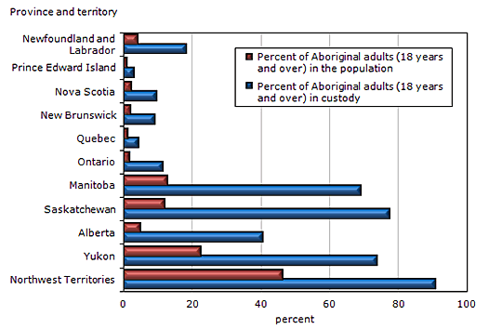
2011 Statistics of Incarceration
Source: Statistics Canada, Canadian Centre for Justice Statistics, Integrated Correctional Services Survey.

Slide 6
What is Restorative Justice?
Restorative justice is a response to crime that focuses on restoring the losses suffered by victims, holding offenders accountable for the harm they have caused, and building peace within communities.
It is a different way of thinking about crime and our response to crime

Slide 7
What is Restorative Justice?
It focuses on the harm caused by crime: repairing the harm done to victims and reducing future harm by preventing crime
It is achieved through a cooperative effort by both government and the communities.
It requires offenders to take responsibility for their actions and for the crime that they have caused

Slide 8
Restorative Justice
Video: Restorative Practices to Resolve Conflict/Build Relationships (18:20 mins)
http://www.youtube.com/watch?v=wcLuVeHlrSs

Slide 9
Benefits of Restorative Justice
It views criminal acts more comprehensively: rather than defining crime only as lawbreaking, it recognizes that offenders harm victims.
It involves more parties: rather than giving key roles to government and offender it involves the victim and community.

Slide 10
Benefits of Restorative Justice
It measures success differently: rather than measuring how much punishment has been inflicted it measures how much harm has been repaired or prevented.
It recognizes the importance of community involvement and initiative rather than leaving the problem of crime alone to the government

Slide 11
Values of Restorative Justice
Encounter - Create opportunities for victims, offenders and community members who want to do so to meet to discuss the crime and its aftermath
Amends - Expect offenders to take steps to repair the harm they have caused
Reintegration - Seek to restore victims and offenders as whole, contributing members of society.
Inclusion - Provide opportunities for parties involved in a specific crime to participate in its resolution.

